Slide 1
NLP

Slide 2
Introduction to NLP
Perceptrons

Slide 3
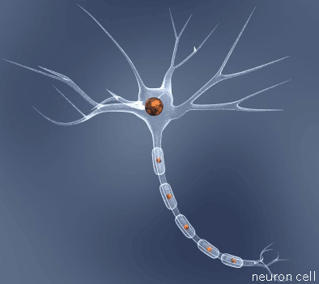
The Perceptron
A simple but very important (discriminative) classifier
Model of a neuron
Input excitations
If excitation > inhibition, send an electrical signal out the axon
Earliest neural network
invented in 1957 by Frank Rosenblatt at Cornell

Slide 4
Perceptron Idea
Input
-1
x₀
no
w₀
x₁
w₁
Σ
> threshold?
w₂
x₂
yes
1
Question: Where can we get these weights?

Slide 5
Quick Reminder: Dot Products
This equation
3
x
2
y
5
z
7
3
x
2
y
5
z
can be written as a dot product of two vectors:
x
7
3
2
5
y
z

Slide 6

So we can rewrite
x₀
w₀
x₁
w₁
Σ
w₂
x₂
as a dot product of two vectors
$$\overset{⃑}{w}∙\overset{⃑}{x}$$

Slide 7
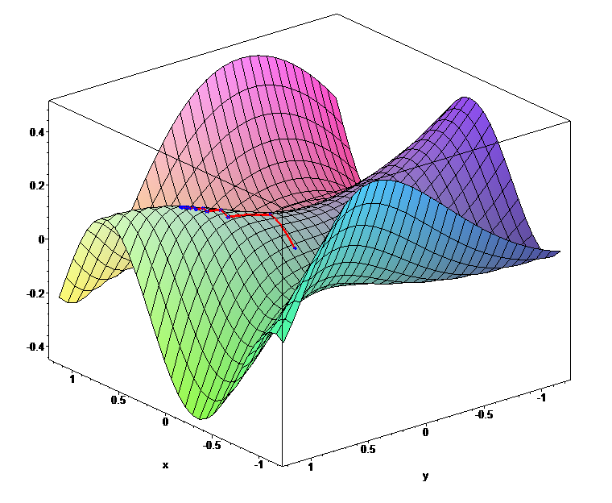
Derivatives and Gradients
https://en.wikipedia.org/wiki/Gradient_descent

Slide 8
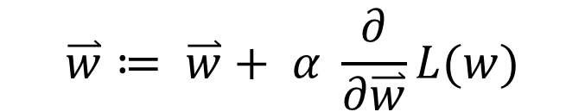
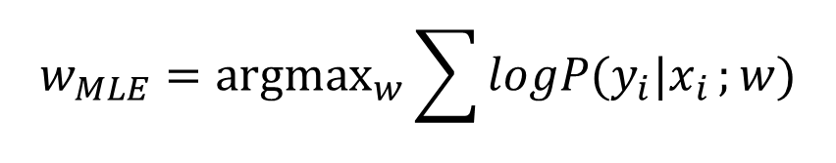
Updating Parameters
Basic approach
We want to increase the probability of the entire data set
Gradient ascent
Take the derivative of the log likelihood with respect to the parameters
Make a little change to the parameters in the direction the derivative tells you is uphill:
α here is the learning rate
how much do you want to change each time?
$$w_{MLE}={\text{argmax}}_{w}\sum{{logP(y}_{i}|x_{i}};w)$$
$$\overset{⃑}{w}≔ \overset{⃑}{w}+ α \frac{∂}{∂\overset{⃑}{w}}L(w)$$
Notes:
If you don’t know how to do this math, don’t worry. It’s not required for the course. Besides, this is what we have computers for.

Slide 9
Perceptron Algorithm
Input:
Algorithm:
Output:

Slide 10
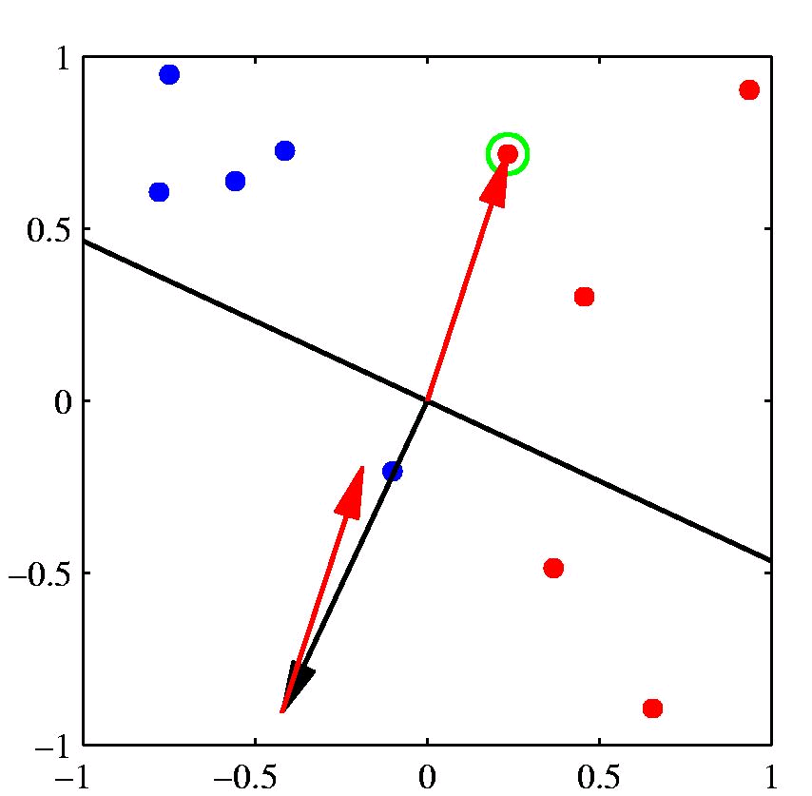
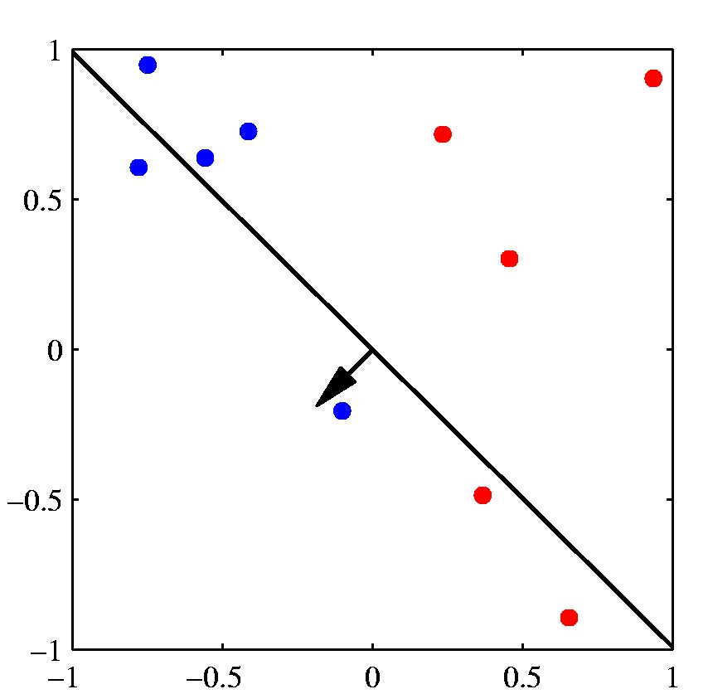
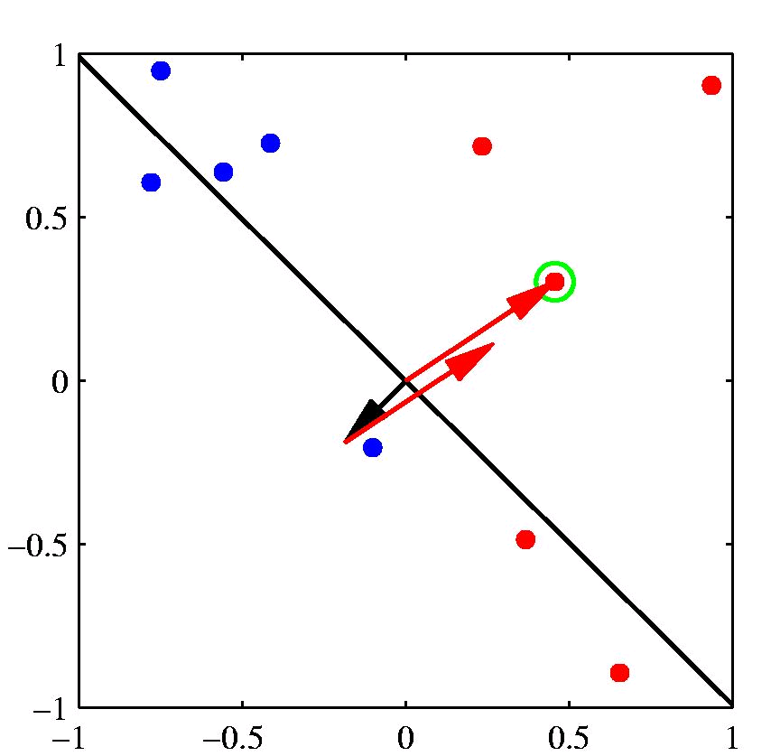
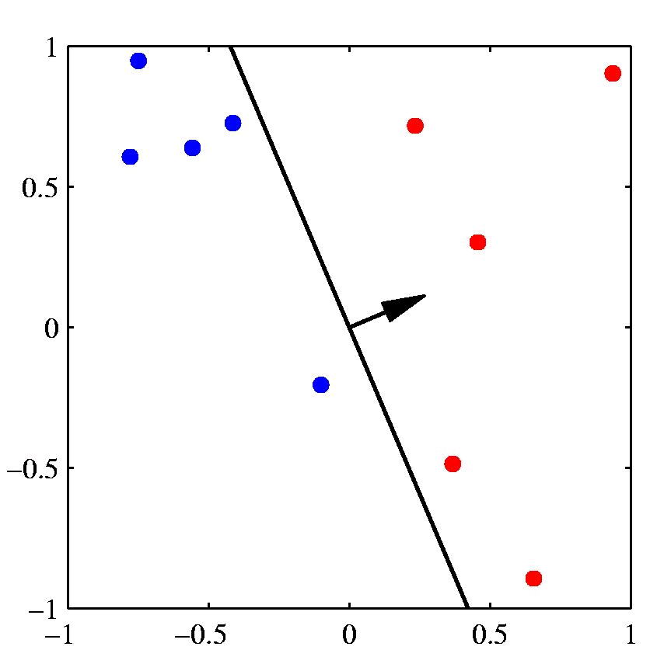
[Example: Chris Bishop]

Slide 11
Gradient Ascent Example
Starting value
w = (1,-1,-2,3)
accuracy 66%
Next value
w = (2,-2,-1,2)
accuracy 73%
Next value
w = (3,-2,-1,4)
accuracy 80%
etc.

Slide 12
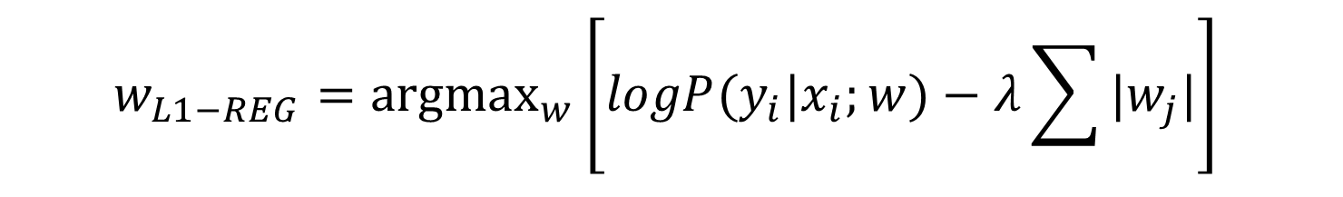
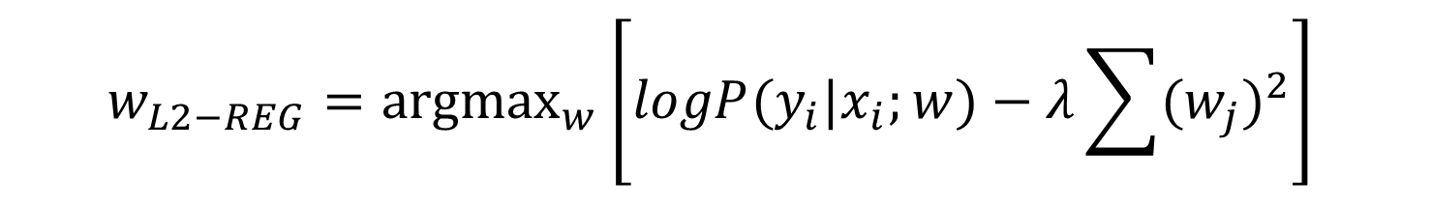
Regularization
Penalize large weights (we don’t want weights of 500,000)
L₂ regularizer
L₁ regularizer
$$w_{L2−REG}={\text{argmax}}_{w}{\left[logP(y_{i}|x_{i};w)−λ\sum{{(w_{j})}^{2}}\right]}_{ }$$
$$w_{L1−REG}={\text{argmax}}_{w}{\left[logP(y_{i}|x_{i};w)−λ\sum{|w_{j}|}\right]}_{ }$$

Slide 13


Stochastic Gradient Descent
Batch mode
Consider each data point for each update of w
This is slow
Stochastic mode
Update w after each data point
Logistic regression stochastic update (p is between 0 and 1)
Perceptron stochastic update (y is 0 or 1; approximation for LR)
$$w_{i}+α\left(y−\hat{p}\left(x\right)\right)x_{i}$$
$$w_{i}+α\left(y−\hat{y}\right)x_{i}$$

Slide 14
Notes
Datasets:
http://blog.webkid.io/datasets-for-machine-learning/

Slide 15
NLP

